Slide 1
Computer Science
Analysis Algorithms
Samuel Lukas

Slide 2
Introduction
An algorithm is a sequence of well-defined instructions for completing a task or solving a problem. It can be described in a natural language, pseudo-code, a flow-chart, or even a programming language.
Example 01 :
Suppose we are interested in knowing whether a specific number is contained in a given sequence of numbers, by traversing the entire number sequence from a certain beginning number

Slide 3
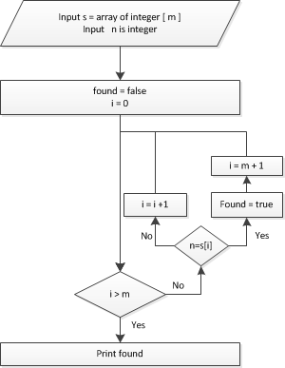
An example of Algorithms
Input s = array of integer [m]
Input n
found = false
For i = 0 to m
If n = s[i] then
found = true
i = m + 1
Return found

Slide 4
Characteristics of Algorithms
Has input and output
Every step is well defined
Finite process / there is an ending
The process is effective
Example 02 :
Suppose we are interested in knowing whether a specific number is contained in a given sorted sequence of numbers, then we do not need do traversing the entire number sequence → Binary search algorithms

Slide 5
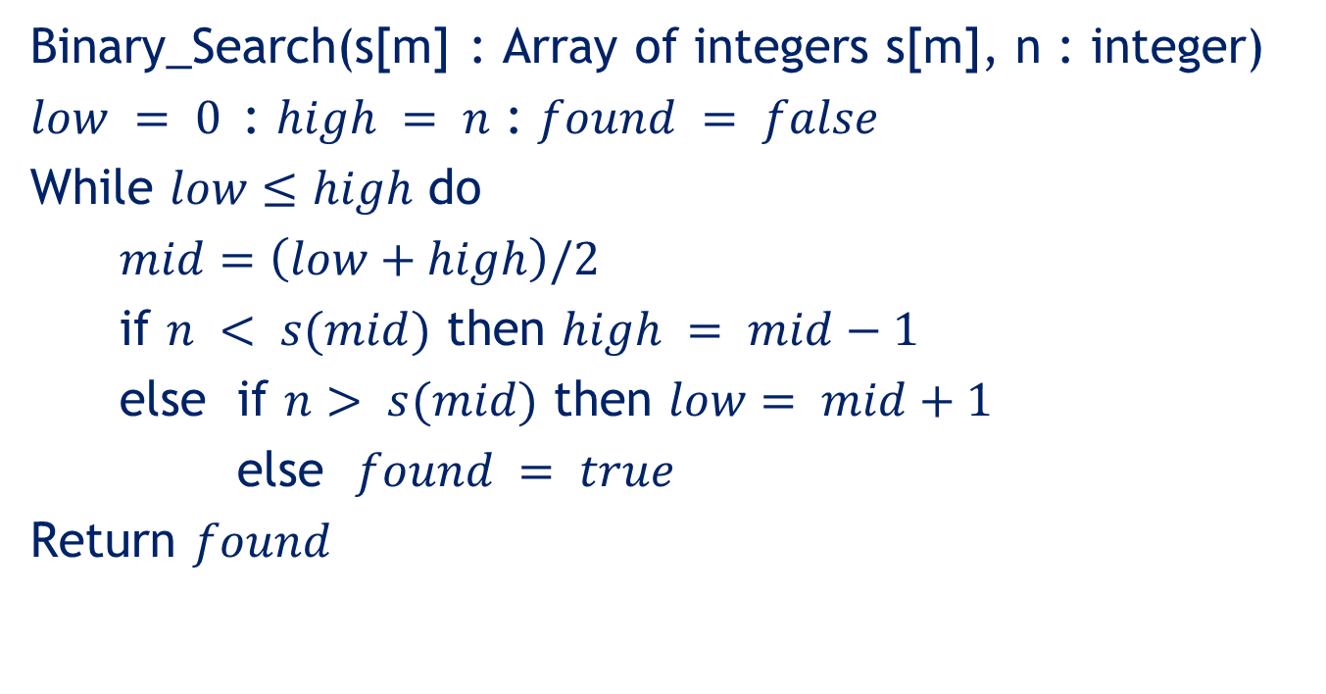
Binary Search Algorithms
Binary_Search(s[m] : Array of integers s[m], n : integer)
$low = 0$: $high = n$ : $found = false$
While $low≤high$ do
$mid=\left(low+high\right)/2$
if $n < s(mid)$ then $high = mid−1$
else if $n> s(mid)$ then $low= mid+1$
else $found = true$
Return $found$

Slide 6
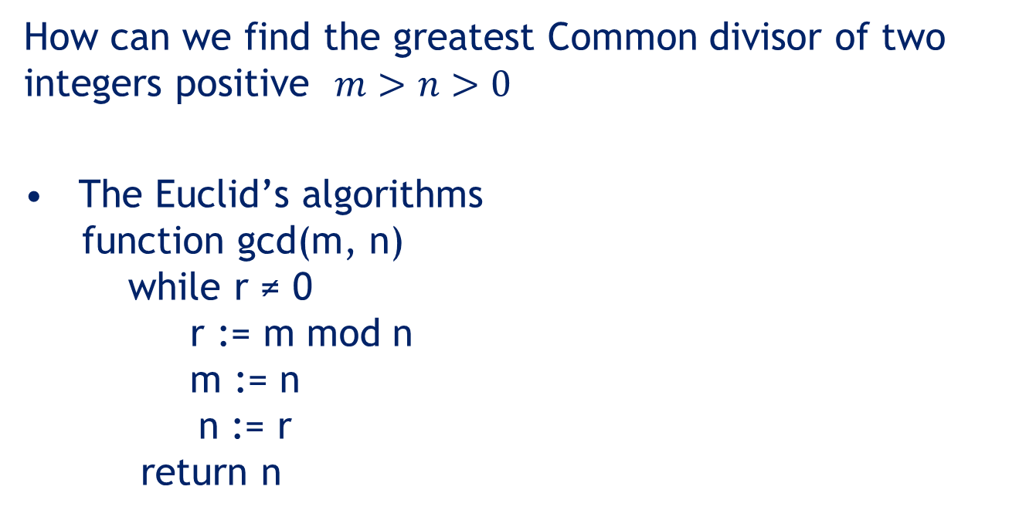
Euclid’s algorithm
How can we find the greatest Common divisor of two integers positive $m>n>0$
The Euclid’s algorithms
function gcd(m, n)
while r ≠ 0
r := m mod n
m := n
n := r
return n

Slide 7

Example 03
Find the greatest common devisor of (1456,1252)
function gcd(m, n)
$$\gcd\left(1456,1252\right)=4$$
Iteration | m | n | r
1 | 1456 | 1252 | 204
2 | 1252 | 204 | 28
3 | 204 | 28 | 8
4 | 28 | 8 | 4
5 | 8 | 4 | 0

Slide 8
Number of Steps of Example 1
Calculate the number of steps for example 01, 02 and 03
Input s = array of integer [n]
Input n
found = false
1
For i = 0 to n
n+1
If n = s[i] then
found = true
i = m + 1
n
1
1
Return found
Number of steps = 2n + 5

Slide 9









Number of Steps of Example 2
Binary_Search(s[m] : Array of integers s[m], n : integer)
$low = 0$: $high = n$ : $found = false$
While $low≤high$ do
$mid=\left(low+high\right)/2$
if $n < s(mid)$ then
$high = mid−1$
else if $n> s(mid)$ then
$$low= mid+1$$
else $found = true$
Return $found$
….……………..3
$${…………………………………….log}_{2}(n)$$
$${…………………………….log}_{2}(n)$$
$${………………………….………log}_{2}(n)$$
$${……………………….log}_{2}\left(n\right) −k_{1}$$
$${……………………………………k}_{1}$$
$${…………………………log}_{2}\left(n\right)− k_{2}$$
$${…………………………………..k}_{2}$$
$$………………………………………………………1$$
$${∴Number of steps= 5log}_{2}\left(n\right)+4$$

Slide 10

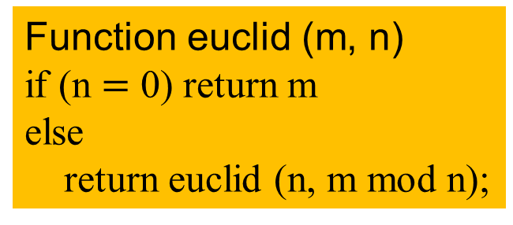
Number of Steps of Example 3
The Euclid’s algorithms
function gcd(m, n)
while n ≠ 0
t := n
n := m mod n
m := t
return m
Recursive process
Function euclid (m, n)
if (n $=$ 0) return m
else
return euclid (n, m mod n);
$$if m>n>0, algorithm terminates after at most$$
$$1+\log_{∅}\left(\frac{n}{\gcd\left(m,n\right)}\right)iterations, where ∅=\frac{1+\sqrt{5}}{2}$$

Slide 11
Evaluation of an Algorithms
Execution time
Memory needed
Clearness of the algorithms
Execution time is proportional with the number of steps of the program. The bigger the number of steps than execution time is longer.

Slide 12
Exercise (1)
Given N positive integers as S(n) and given a value K. Find how many clusters can be made from that positive integers. Two integers belong to the same cluster if there difference is no larger than K
Some examples
S(n) = {2,6,1,7,3,4,9} K = 1 → Cluster = {{1,2,3,4},{6,7},{9}}
S(n) = {2,6,1,7,3,4,9} K = 2 → Cluster = {1,2,3,46,7,9}
S(n) = {15,1,20,4,17} K = 5 → Cluster = {{1,4},{15,17,20}}

Slide 13
Exercise (2)
Given N Lamps numbered from 1 to N and K switches labeled with prime number each. Each switch is connected to all lamps whose number is a multiple of that prime number. Pressing a switch will toggle the condition of all lamps which are connected to the pressed switch. You can press only one switch at one time. If initial condition all lamps are off. Determine which lamp is on after switches are pressed x times in a certain sequences.
Some examples
N= 10, K = {2,5}
P(3) = {2,5,2} → On = {5,10}
P(7) = {2,5,2,5,2,2,2} → On = {2,4,6,8,10}

Slide 14
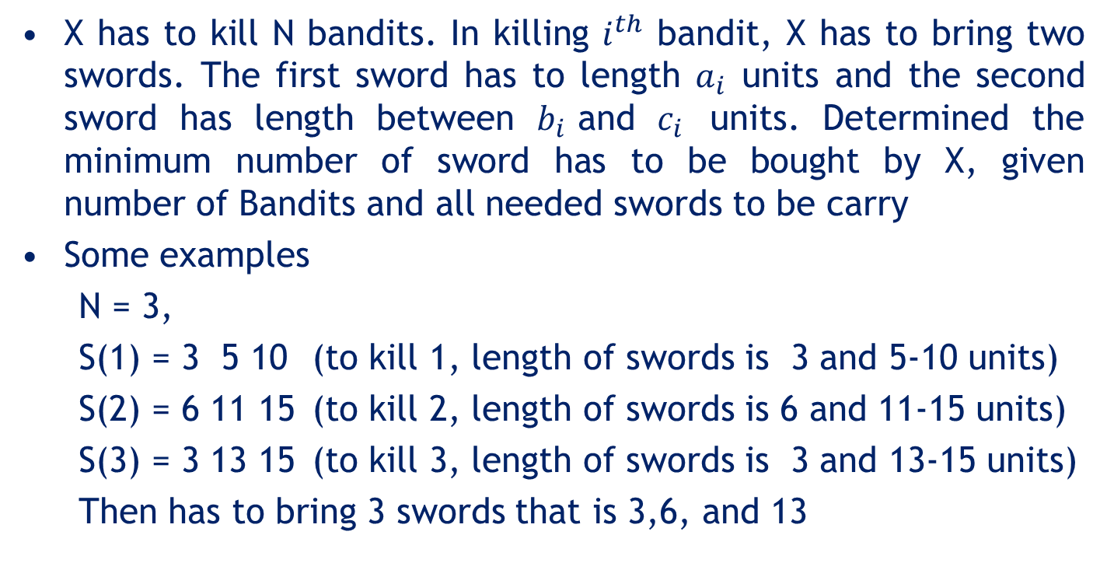
Exercise (3)
X has to kill N bandits. In killing $i^{th}$ bandit, X has to bring two swords. The first sword has to length $a_{i}$ units and the second sword has length between $b_{i}$and $c_{i}$ units. Determined the minimum number of sword has to be bought by X, given number of Bandits and all needed swords to be carry
Some examples
N = 3,
S(1) = 3 5 10 (to kill 1, length of swords is 3 and 5-10 units)
S(2) = 6 11 15 (to kill 2, length of swords is 6 and 11-15 units)
S(3) = 3 13 15 (to kill 3, length of swords is 3 and 13-15 units)
Then has to bring 3 swords that is 3,6, and 13

